Slide 1
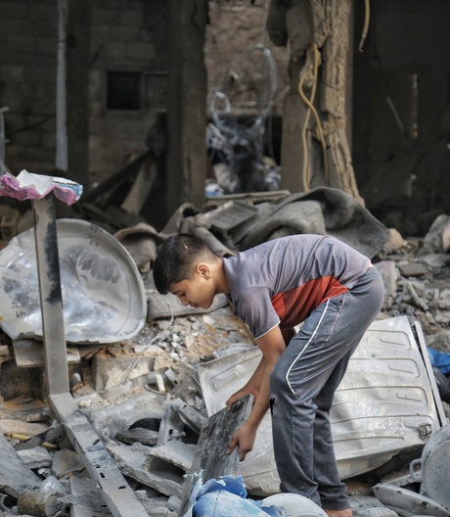

2022 Intersectoral People in Need Key findings and trends

Slide 2
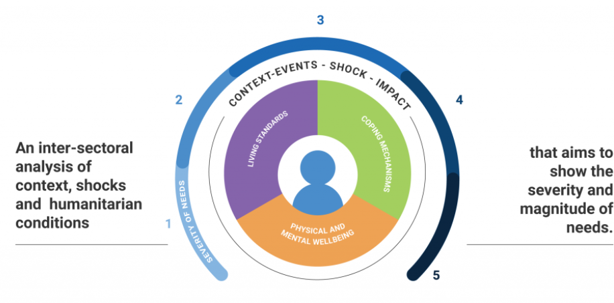
Joint Inter-sectoral Analytical Framework (JIAF): What is it?
Purpose of JIAF is to promote a collaborative approach for inter-sectoral analysis which enables humanitarian actors to arrive at a common understanding of:
what the priority humanitarian needs are
where humanitarian needs are most severe
which population groups are most in need of humanitarian assistance
https://www.jiaf.info/
Notes:
Why: To respond to the call for a more rigorous, transparent and people-centred overview of people's needs and their severity, so that we can collectively respond better to people in crisis.
Whom: OCHA and the clusters lead the JIAF analysis in each crisis context to inform response plans. Local partners and populations are critical actors in the process. Donors use the JIAF analysis to inform their contribution to responses.
A theoretical and conceptual framework for inter-sectoral needs analysis to inform strategic decision-making across humanitarian crises
JIAF is an output of the work being done by the Joint Inter- Sector Analysis Working Group (JIAG) since 2017
JIAG was formed as a direct result of Grand Bargain Commitment 5 following the 2016 World Humanitarian Summit
JIAG is an inter-agency initiative globally co-led by OCHA and Global Cluster Coordinators Group (GCCG

Slide 3
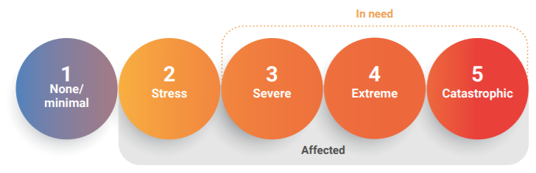
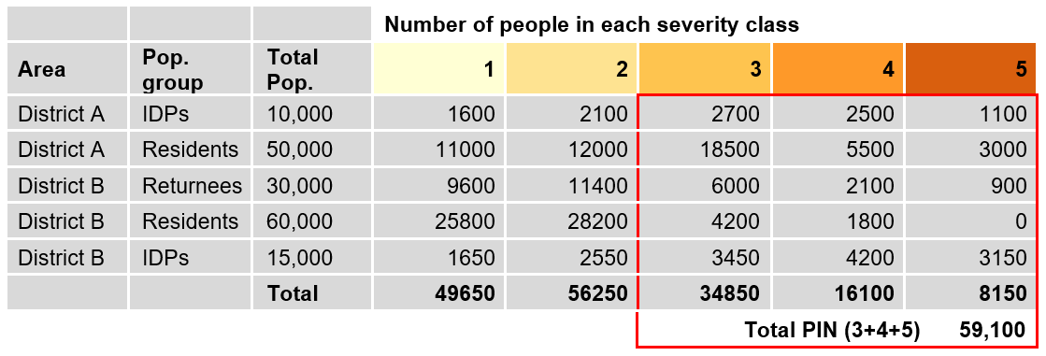
JIAF Aggregation Methodology
21 indicators adopted in the intersectoral model in consultation with the CCs/IMOs
The JIAF provides a methodology for calculating the sectoral and inter-sectoral PiN and severity figures in the HNO
Five level thresholds were assigned for each indicator

Slide 4
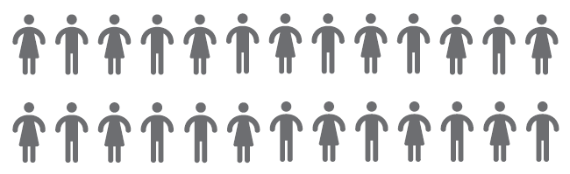
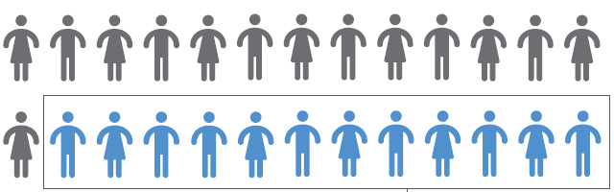


Summary of Humanitarian Needs
Severity of Needs
Total Population
5.3M
People in Need
2.1M
5.3 M
Source: PCBS, 2021 projection
Notes:
The overall PIN of 2022 is 2.1 M out of 5.3 M Palestinian (2022 projection)

Slide 5
PIN by year
MSNA
JIAF approach

Slide 6
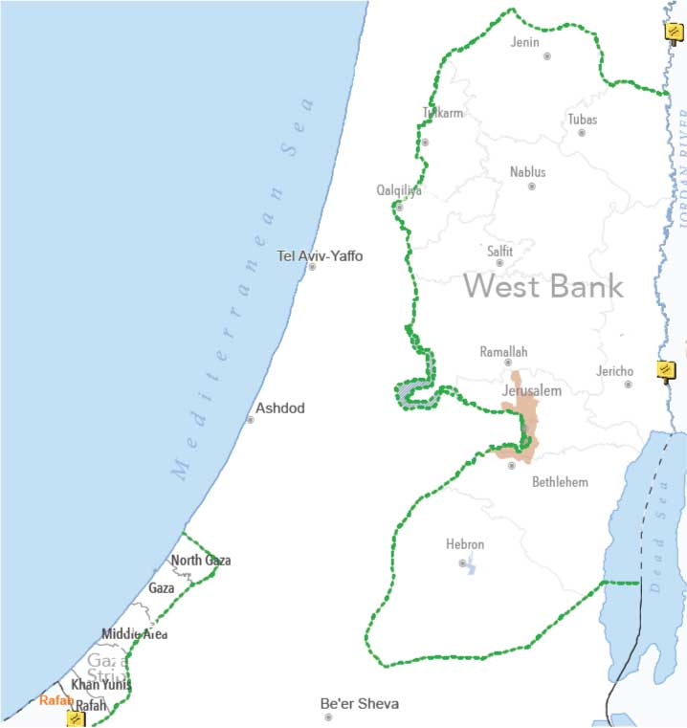
PIN by Geography
PIN
2.1m
64% of people in need lives in Gaza
36% of people in need lives in the West Bank.
63% of Gaza residents need humanitarian assistance
21% of West Bank residents need humanitarian assistance
0.75m
43%
stressed
1.3m

Slide 7
PIN by Geography and Severity
WEST BANK
GAZA
Notes:
53% of Gaza PIN are severely impacted by the crisis compared to 20% in the West Bank
10% of Gaza PIN are extremely impacted by the crisis compared to 1% in the West Bank

Slide 8
PIN by Geography and Severity

Slide 9
Needs Indicators contributing to PIN in
Area A and B
Livelihoods: % of HHs unable to afford basic needs
Livelihoods: % of HHs whose average monthly HH income per HH member was less than 1450 NIS
Food Security:% of HHs relying on stress/crisis/emergency strategies to cope with a lack of food or money to buy food
Health: % of HH where at least one member (SADD) is reporting signs of distress (self-diagnosed)
Education:% of HHs with school-aged children (who were previously attending school) NOT continuing teaching and learning activities remotely
WASH: % of people with inadequate access to sanitation services
AAP:% HH satisfied with aid received % HH with access/knowledge of complaint mechanisms

Slide 10
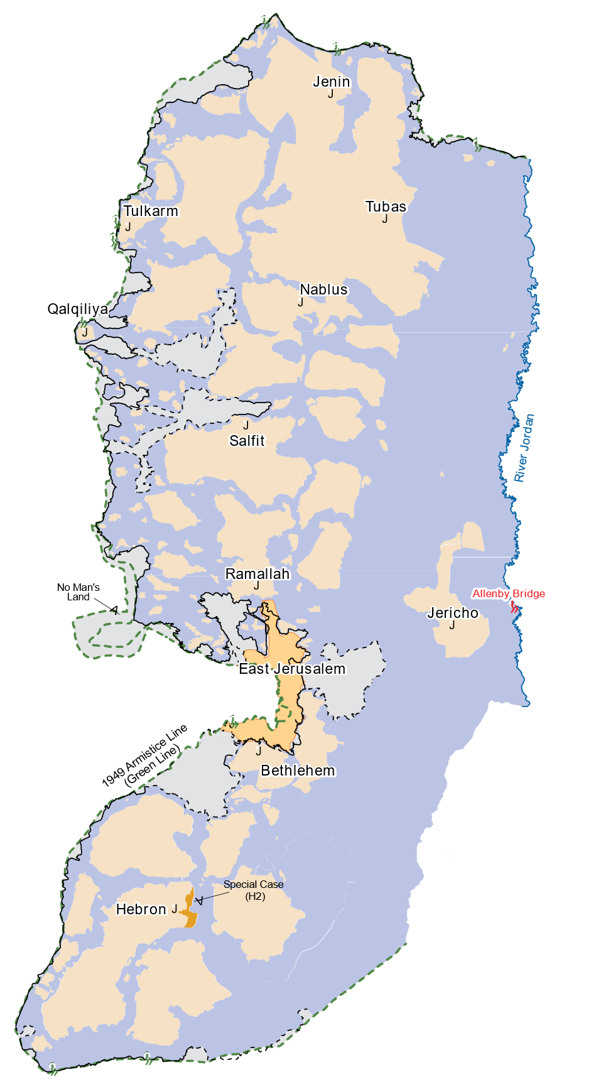




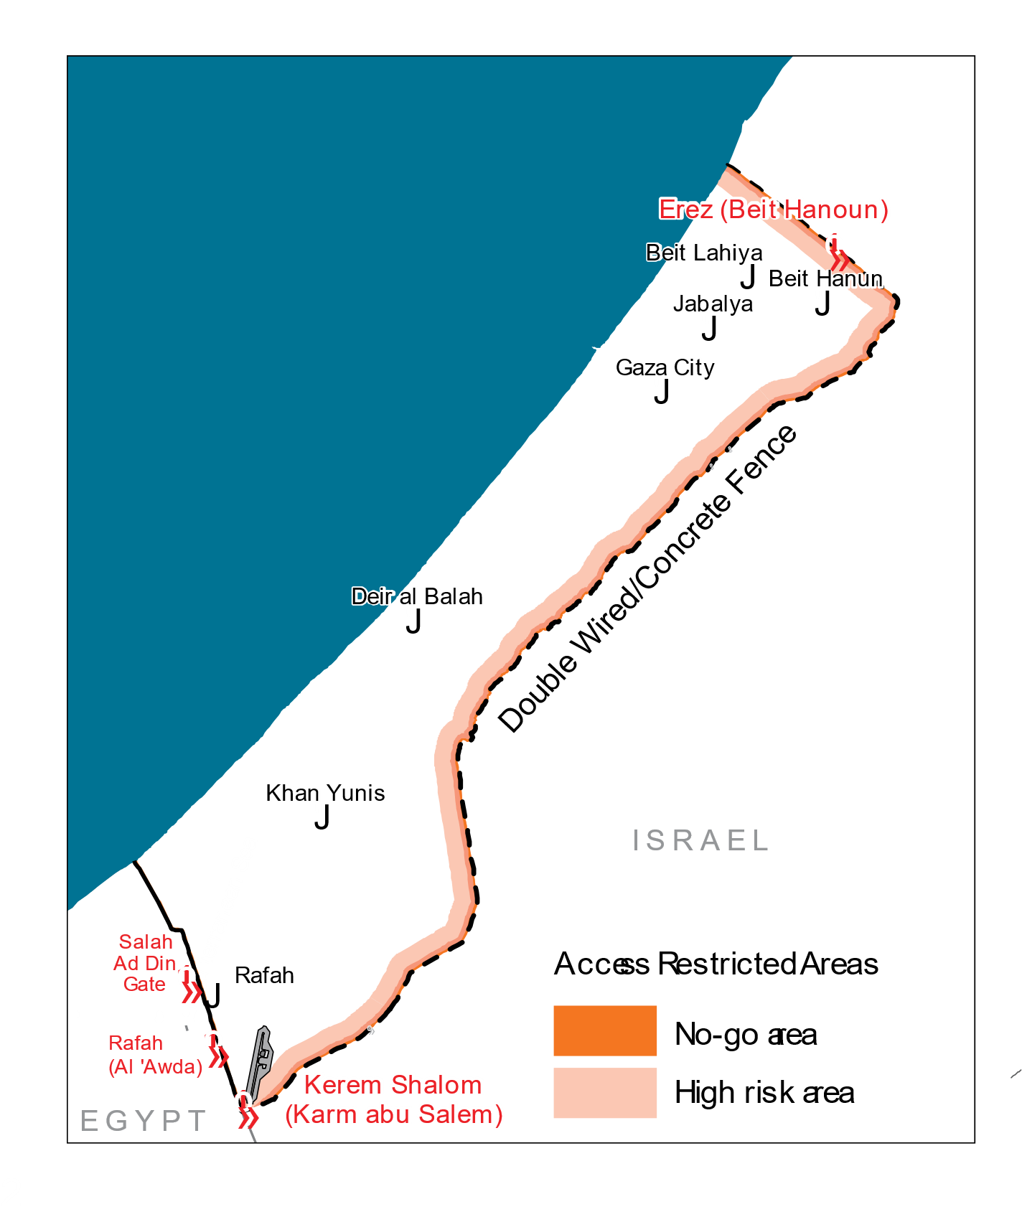
PIN by Geography
Gaza
Area A&B
Area C
H2
East Jerusalem
1.3 m
615K
111K
12K
9K
Notes:
s_2_AAP_% HH satisfied with aid received % HH with access/knowledge of complaint mechanisms
s_5_Education_% of HHs with school-aged children (who were previously attending school) NOT continuing teaching and learning activities remotely
s_6_Food Security_% of HHs relying on stress/crisis/emergency strategies to cope with a lack of food or money to buy food
s_10_Health_% of HH where at least one member (SADD) is reporting signs of distress (self-diagnosed)
s_16_WASH_% of people with inadequate access to sanitation services
s_18_Livelihoods_% of HHs unable to afford basic needs
s_19_Livelihoods_% of HHs whose average monthly HH income per HH member was less than __ NIS

Slide 11




PIN by Gender and Age
0.93m
Children
1.1m
Adult
62k
Elderly

Slide 12
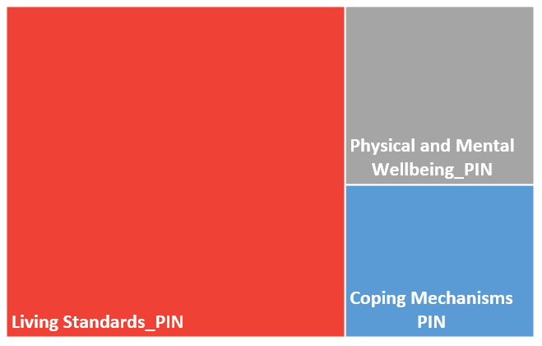
PIN by Humanitarian Condition/Critical Problem
Coping Mechanisms PIN | 17%
Living Standards PIN | 64%
Physical and Mental Wellbeing PIN | 19%

Slide 13
PIN by Humanitarian Condition/Critical Problem

Slide 14
PIN by Demographic Group

Slide 15
Intersectoral
Data Analysis
Model

